Slide 1
Stock Market Prediction
Aditi Agarwal
University Roll No.: 2017448
Mentor: Mr. Ashwini Kumar

Slide 2

Introduction
The stock market is a place where publicly traded companies' stocks are bought and sold. It is a public marketplace where securities, such as stocks, bonds, and options, are bought and sold. The stock market allows companies to raise money by selling stocks to investors, and it allows investors to buy and sell stocks in publicly traded companies.
Buying and selling stocks can be a risky jobs if done without any insights or pre-planning. To avoid having big losses people produced various techniques, once such technique is Stock prediction using machine learning where we train computers using previous data so it can predict the stock prices for us.

Slide 3
Methodology
The main methodology that this project uses and is essentially build upon is LSTM or Long Short-Term Memory.
LSTM, or Long Short-Term Memory, is a type of neural network architecture commonly used in machine learning for tasks such as natural language processing and time series prediction.
The LSTM architecture consists of three main components: the forget gate, the input gate, and the output gate. These gates control the flow of information through the LSTM cell, allowing it to store and retrieve information over a longer period.

Slide 4
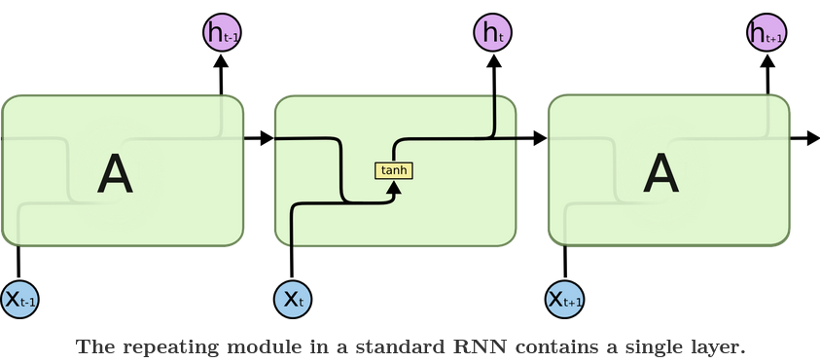
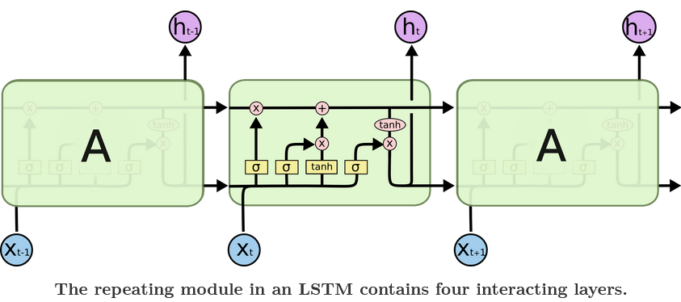
Long short term memory
Normal Neural Network
LSTM Model

Slide 5
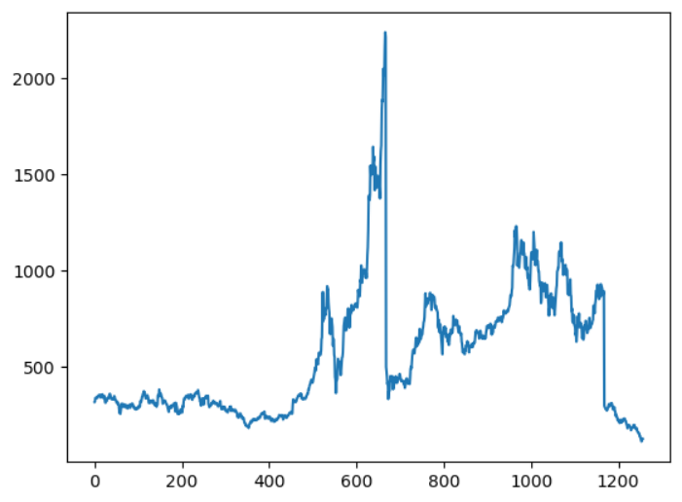
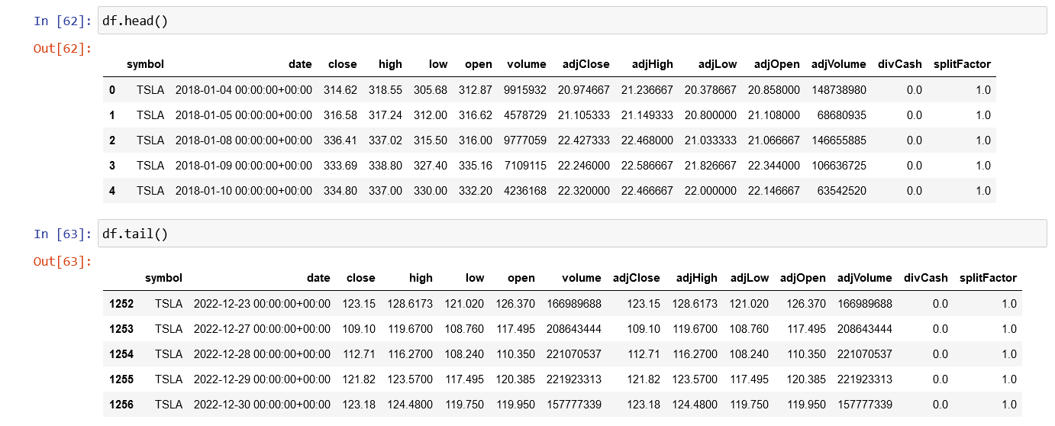
Results and Discussions
The data used in this project is of Tesla Inc. and the close prices of the TSLA stock is displayed in a graph on the right. Below the text you can also see the numerical representation of the before mentioned stock.

Slide 6
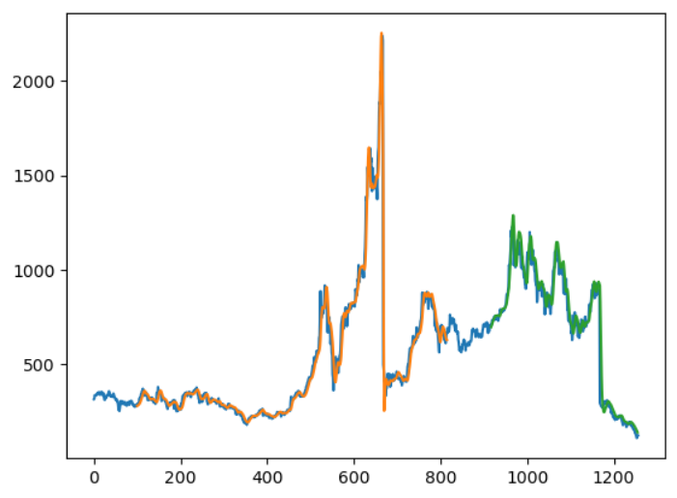
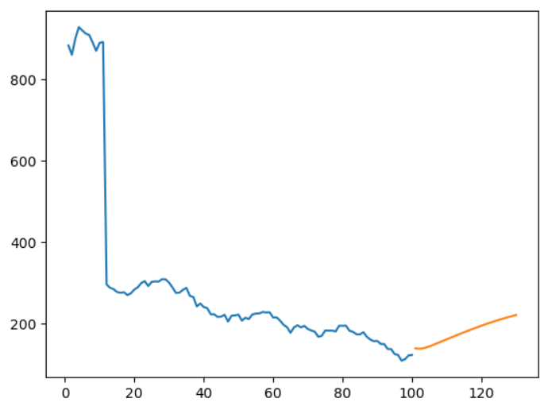

Trained Predicted
After training the model we can see that the trained and the tested dataset work satisfactorily close to the original dataset. Hence using the same model, we can predict the data for future.
In the graphs below we can see the new data predicted. The new data is represented by the orange line and then it’s shown how it will look when combined with the entire dataset.
Actual Data
Test Predicted

Slide 7
Conclusion and future work

Slide 8
We saw that this project gave satisfactory results with the data produced. This model is not recommended to be used for real investing. Some future work that can be done on this project is :
Some potential areas for future work with this project include:
Expanding the dataset: The current dataset may not be representative of all possible market conditions, so expanding it to include more data from different time periods and market conditions could improve the model's accuracy.
Incorporating additional features: The model may be able to make more accurate predictions by incorporating additional features such as news articles, economic indicators, and technical analysis indicators. Predictions for future prices can also be a very intriguing addition.
Exploring different LSTM configurations: The current LSTM architecture may not be optimal for stock prediction, so experimenting with different configurations such as the number of layers, the size of the hidden state, and the use of dropout could lead to improved performance.
Evaluating the model's performance on different stocks: The model may perform differently on different stocks, so testing it on a diverse range of stocks could provide insight into its generalizability.
Developing a real-time stock prediction system: Creating a system that continuously updates the model with new data and makes real-time predictions could have practical applications for investors.

Slide 9
THANK YOU

